Slide 1
Augmentation
Additional State

Slide 2
Requirements
New state should not be measured directly.
Structurally non-absorbable by the rigid baseline
The effect of the added state must be visible enough in the measured signals for the augmentation to detect it
Physically interpretable
Notes:
Hidden from the output
(if I plant o add noise SNR: compare hidden-state contribution to noise
map:

Slide 3
Requirements
New state should not be measured directly.
  Indirect visible through dynamics: We only see the effect of it / it disturbs the measured motion
Structurally non-absorbable by the rigid baseline
  The original baseline model can’t fake the effect by changing its parameter values → the baseline would need to add states to imitate it
The effect of the added state must be visible enough in the measured signals for the augmentation to detect it
  Could be quantified before implementing augmentation:
    Relative output contribution compared to total measured motion
    Residual of best re-identified model after refitting the baseline parameters on data
Physically interpretable
  Relevant to the gantry
Notes:
Hidden from the output
(if I plant o add noise SNR: compare hidden-state contribution to noise
map:

Slide 4
Suggestion
Additional Mass Spring Damper attached to payload mass (mh)
  Position and velocity as additional states
  Similar to Jan adding MSD

Slide 5

Suggestions
Hidden internal moving mass $\left[r , \dot{r}\right]$
  Position and velocity
Hidden rotational compliance at the payload location $\left[q , \dot{q}\right]$
  Might be weak signal to recover from data

Slide 6
Suggestions
Hidden compliance attached at the payload location, not as an extra measured Y-axis mode / hidden spring-mass-damper attached at the payload position on the crossarm

Slide 7

Comparison with Jan

Slide 8
Comparison with Jan
With p3 the position of the additional mass - not measured

Slide 9


Slide 12
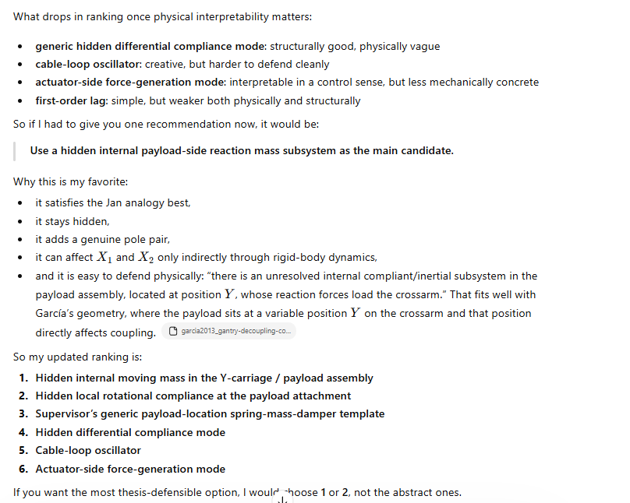

Slide 13
1. Hidden internal moving mass inside the Y-carriage / payload
2. Hidden differential attachment compliance between crossarm and the two X-side supports

Slide 14
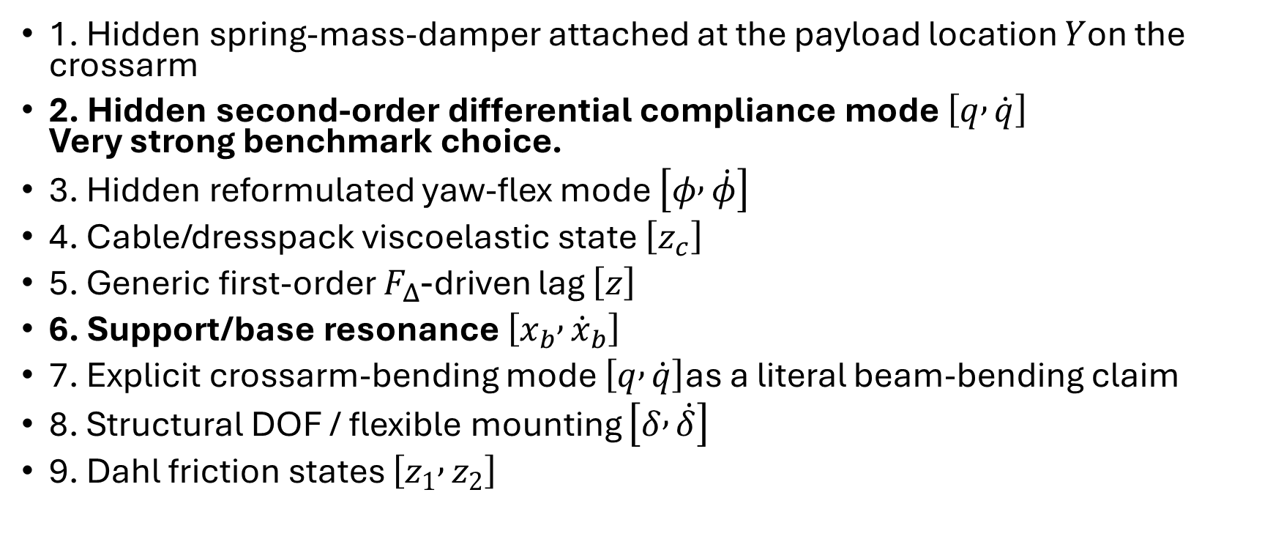
1. Hidden spring-mass-damper attached at the payload location $Y$on the crossarm
2. Hidden second-order differential compliance mode $\left[q , \dot{q}\right]$
Very strong benchmark choice.
3. Hidden reformulated yaw-flex mode $\left[φ , \dot{φ}\right]$
4. Cable/dresspack viscoelastic state $\left[z_{c}\right]$
5. Generic first-order $F_{Δ}$-driven lag $\left[z\right]$
6. Support/base resonance $\left[x_{b} , {\dot{x}}_{b}\right]$
7. Explicit crossarm-bending mode $\left[q , \dot{q}\right]$as a literal beam-bending claim
8. Structural DOF / flexible mounting $\left[δ , \dot{δ}\right]$
9. Dahl friction states $\left[z_{1} , z_{2}\right]$

Slide 15

Lagrange-Euler - Garcia

Slide 16
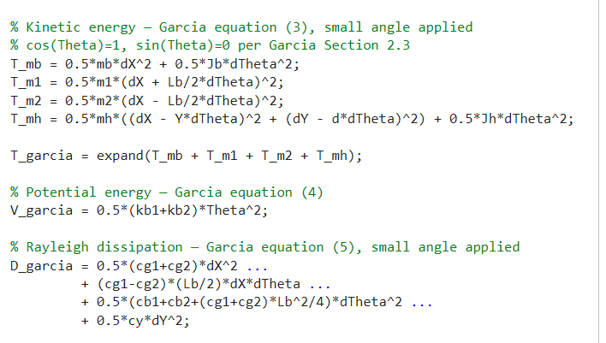
Lagrange-Euler - Garcia

Slide 17
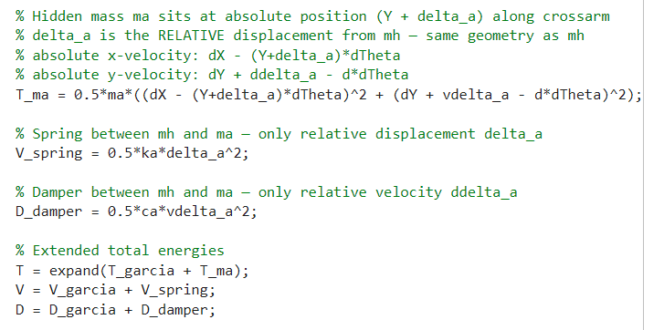
Lagrange-Euler – Additional state
Notes:
Why $T_{ma}$Has No $J_{a}$Term
$m_{a}$is modeled as a point mass — it has no rotational inertia about its own center of mass.
Linear spring: linear spring potential energy
Jan also has linear spring…?

Slide 18
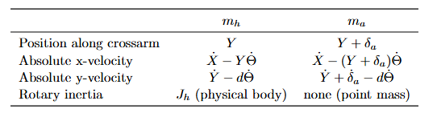
Lagrange-Euler – Additional state
Notes:
Why $T_{ma}$Has No $J_{a}$Term
$m_{a}$is modeled as a point mass — it has no rotational inertia about its own center of mass.
Linear spring: linear spring potential energy
Jan also has linear spring…?

Slide 19
Lagrange-Euler – Additional state

Slide 20
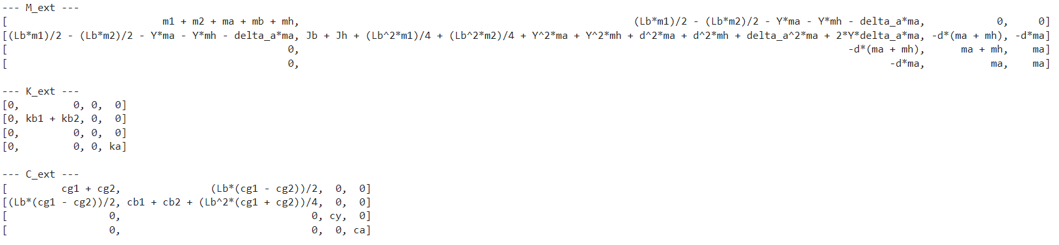
Symbolic toolbox result

